Slide 1

What is network security?
confidentiality: only sender, intended receiver should “understand” message contents
sender encrypts message
receiver decrypts message
authentication: sender, receiver want to confirm identity of each other
message integrity: sender, receiver want to ensure message not altered (in transit, or afterwards) without detection e.g #
access and availability: services must be accessible and available to users
Notes:
Confidentiality:being kept secret or private.

Slide 2
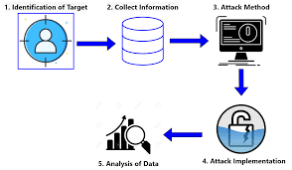
There are bad guys (and girls) out there!
Q: What can a “bad guy” do?
A: A lot! (recall section 1.6)
eavesdrop: intercept messages
actively insert messages into connection
impersonation: can fake (spoof) source address in packet (or any field in packet)
hijacking: “take over” ongoing connection by removing sender or receiver, inserting himself in place
denial of service: prevent service from being used by others (e.g., by overloading resources)

Slide 3
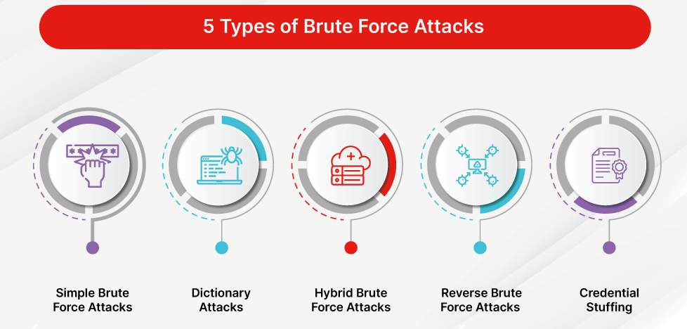
Breaking an encryption scheme
cipher-text only attack: Trudy has ciphertext she can analyze
two approaches:
brute force: search through all keys
statistical analysis
known-plaintext attack: Trudy has plaintext corresponding to ciphertext
e.g., in monoalphabetic cipher, Trudy determines pairings for a,l,i,c,e,b,o,
chosen-plaintext attack: Trudy can get ciphertext for chosen plaintext

Slide 4





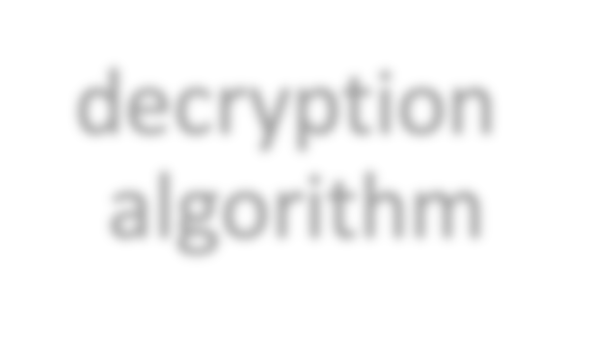

Symmetric key cryptography
K_{S}
K_{S}
plaintext
encryption algorithm
ciphertext
K_{S}(m)
plaintext
decryption algorithm
symmetric key crypto: Bob and Alice share same (symmetric) key: K
e.g., key is knowing substitution pattern in mono alphabetic substitution cipher
Q: how do Bob and Alice agree on key value?

Slide 5

Simple encryption scheme
substitution cipher: substituting one thing for another
monoalphabetic cipher: substitute one letter for another
plaintext: abcdefghijklmnopqrstuvwxyz ciphertext: mnbvcxzasdfghjklpoiuytrewq
e.g.:
Encryption key: mapping from set of 26 letters to set of 26 letters
Plaintext: | bob. | i | love | you. | alice
ciphertext: | nkn. | s | gktc | wky. | mgsbc

Slide 6

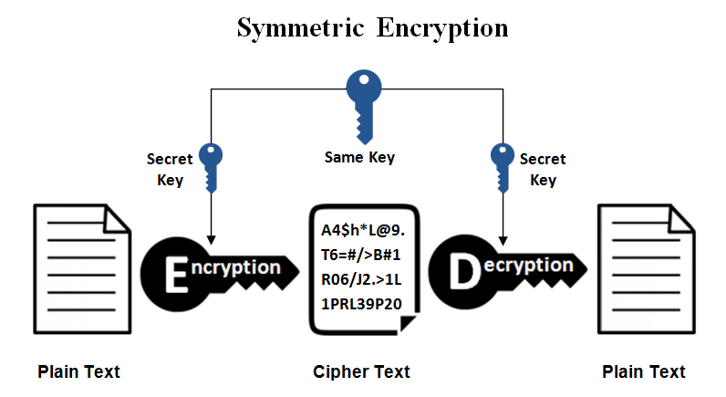
Symmetric key crypto: DES
DES: Data Encryption Standard
US encryption standard [NIST 1993]
56-bit symmetric key, 64-bit plaintext input
block cipher with cipher block chaining
how secure is DES?
DES Challenge: 56-bit-key-encrypted phrase decrypted (brute force) in less than a day
no known good analytic attack
making DES more secure:
3DES: encrypt 3 times with 3 different keys

Slide 7
AES: Advanced Encryption Standard
symmetric-key NIST standard, replaced DES (Nov 2001)
processes data in 128 bit blocks
128, 192, or 256 bit keys
brute force decryption (try each key) taking 1 sec on DES, takes 149 trillion years for AES

Slide 8

Public Key Cryptography
symmetric key crypto:
requires sender, receiver know shared secret key
Q: how to agree on key in first place (particularly if never “met”)?
public key crypto
radically different approach [Diffie-Hellman76, RSA78]
sender, receiver do not
share secret key
public encryption key known to all
private decryption key known only to receiver

Slide 9
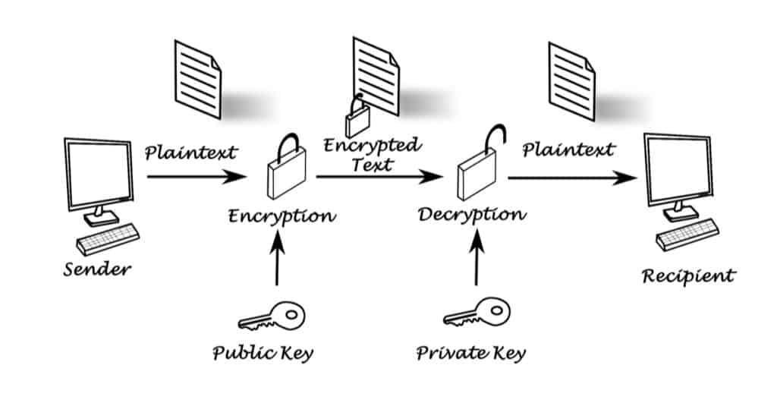
A password is a secret series of characters that is generated by the user in order to verify their identity.
A password can also be used to generate cryptographic keys.

Slide 10


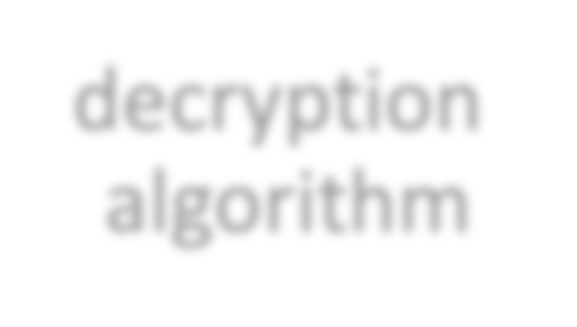

Public Key Cryptography
_{K}+
Bob’s public key
B
_{K} -
Bob’s private key
B
plaintext message, m
encryption algorithm
ciphertext
decryption algorithm
plaintext
K⁺(m)
m = K ⁻ (K⁺(m))
B
B
B
Wow - public key cryptography revolutionized 2000-year-old (previously only symmetric key) cryptography!
similar ideas emerged at roughly same time, independently in US and UK (classified)

Slide 11
Public key encryption algorithms
requirements:
+ .
- .
1 need K_{B} ( ) and K ( ) such that
B
- +
K_{B}(K _{B}(m)) = m
2
given public key K⁺ , it should be impossible to
B
-
compute private key K_{B}
RSA: Rivest, Shamir, Adelson algorithm

Slide 12
Prerequisite: modular arithmetic
x mod n = remainder of x when divide by n
facts:
[(a mod n) + (b mod n)] mod n = (a+b) mod n [(a mod n) - (b mod n)] mod n = (a-b) mod n [(a mod n) * (b mod n)] mod n = (a*b) mod n
thus
(a mod n)^{d} mod n = a^{d} mod n
example: x=14, n=10, d=2:
(x mod n)^{d} mod n = 4² mod 10 = 6 x^{d} = 14² = 196 x^{d} mod 10 = 6

Slide 13
Why is RSA secure?
suppose you know Bob’s public key (n,e). How hard is it to determine d?
essentially need to find factors of n without knowing the two factors p and q
fact: factoring a big number is hard

Slide 14




Digital signatures
cryptographic technique analogous to hand-written signatures:
sender (Bob) digitally signs document: he is document owner/creator.
verifiable, nonforgeable: recipient (Alice) can prove to someone that Bob, and no one else (including Alice), must have signed document
simple digital signature for message m:
Bob signs m by encrypting with his private key K_{B}, creating “signed” message, K_{B}⁻(m)
Bob’s message, m
Dear Alice
Oh, how I have missed you. I think of you all the time! …(blah blah blah)
Bob
_{K} ⁻ Bob’s private
-
m,K (m)
^{B} key
B
Dear Alice
Oh, how I have missed you. I think of you all the time! …(blah blah blah)
Public key encryption algorithm
Bob
⁻ (m)
K
B

Slide 15
Digital signatures
suppose Alice receives msg m, with signature: m, ⁻K (m)
B
Alice verifies m signed by Bob by applying Bob’s public key ⁺K to ⁻K (m)
B B
then checks⁺K (⁻K (m) ) = m.
+
-
B B
If K_{B}(K_{B}(m) ) = m, whoever signed m must have used Bob’s private key
Alice thus verifies that:
Bob signed m
no one else signed m
Bob signed m and not m’
non-repudiation:
-
Alice can take m, and signature K_{B}(m) to court and prove that Bob
signed m

Slide 16
Message digests
computationally expensive to public-key-encrypt long messages
goal: fixed-length, easy- to-compute digital “fingerprint”
apply hash function H to m, get fixed size message digest, H(m)
large message m
Hash function properties:
H: Hash Function
H(m)
many-to-1
produces fixed-size msg digest (fingerprint)
given message digest x, computationally infeasible to find m such that x = H(m)

Slide 17
Internet checksum: poor crypto hash function
Internet checksum has some properties of hash function:
produces fixed length digest (16-bit sum) of message
is many-to-one
but given message with given hash value, it is easy to find another message with same hash value:
message | ASCII format
I O U 1 | 49 4F 55 31
0 0 . 9 | 30 30 2E 39
9 B O B | 39 42 D2 42
B2 C1 D2 AC

Slide 18
Hash function algorithms
MD5 hash function widely used (RFC 1321)
computes 128-bit message digest in 4-step process.
arbitrary 128-bit string x, appears difficult to construct msg m whose MD5 hash is equal to x
SHA-1 is also used
US standard [NIST, FIPS ]
160-bit message digest

Slide 19




Public key Certification Authorities (CA)
certification authority (CA): binds public key to particular entity, E
entity (person, website, router) registers its public key with CE provides “proof of identity” to CA
CA creates certificate binding identity E to E’s public key
certificate containing E’s public key digitally signed by CA: CA says “this is E’s public key”
Bob’s
digital
signature
(encrypt)
public
+
+
key K_{B}
K_{B}
CA’s
certificate for Bob’s public key, signed by CA
private _{K} -
Bob’s identifying information
key
CA

Slide 20




Public key Certification Authorities (CA)
when Alice wants Bob’s public key:
gets Bob’s certificate (Bob or elsewhere)
apply CA’s public key to Bobʼs certificate, get Bob’s public key
digital
signature
(decrypt)
Bob’s public key
+
K_{B}
+
K _{B}
CA’s
public _{K}+
key
CA

Slide 21
Transport-layer security (TLS)
widely deployed security protocol above the transport layer
supported by almost all browsers, web servers: https (port 443)
provides:
confidentiality: via symmetric encryption
all techniques we have studied!
integrity: via cryptographic hashing
authentication: via public key cryptography
history:
early research, implementation: secure network programming, secure sockets
secure socket layer (SSL) deprecated [2015]
TLS 1.3: RFC 8846 [2018]

Slide 22
Transport-layer security: what’s needed?
let’s build a toy TLS protocol, t-tls, to see what’s needed!
we’ve seen the “pieces” already:
handshake: Alice, Bob use their certificates, private keys to authenticate each other, exchange or create shared secret
key derivation: Alice, Bob use shared secret to derive set of keys
data transfer: stream data transfer: data as a series of records
not just one-time transactions
connection closure: special messages to securely close connection

Slide 23

t-tls: encrypting data
recall: TCP provides data byte stream abstraction
Q: can we encrypt data in-stream as written into TCP socket?
A: where would MAC go? If at end, no message integrity until all data received and connection closed!
solution: break stream in series of “records”
each client-to-server record carries a MAC, created using M_{c}
receiver can act on each record as it arrives
t-tls record encrypted using symmetric key, K_{c,} passed to TCP:
K_{c}(
)
length
data
MAC

Slide 24
t-tls: encrypting data (more)
possible attacks on data stream?
re-ordering: man-in middle intercepts TCP segments and reorders (manipulating sequence #s in unencrypted TCP header)
replay
solutions:
use TLS sequence numbers (data, TLS-seq-# incorporated into MAC)
use nonce

Slide 25

t-tls: connection close
truncation attack:
attacker forges TCP connection close segment
one or both sides thinks there is less data than there actually is
solution: record types, with one type for closure
type 0 for data; type 1 for close
MAC now computed using data, type, sequence #
K_{c}(
)
length | type | data | MAC

Slide 26
Transport-layer security (TLS)
TLS provides an API that any application can use
an HTTP view of TLS:
HTTP 1.0
HTTP/2
HTTP/2 (slimmed)
Application
QUIC
HTTP/3
TLS
Transport
TCP
TCP
UDP
Network
IP
IP
IP
HTTP/2 over TCP
HTTP/2 over TCP
HTTP/2 over QUIC (which incorporates TLS) over UDP

